Slide 1
METS Intro & Overview
Mets Opening Day Germany
May 7, 2007
Nancy J. Hoebelheinrich
Stanford University Libraries

Slide 2
METS Intro & Overview: outline of topics
The problem to solve
Brief history
Who is using? For what?
Technical Components
Maintaining the specs
Documentation & training
The METS Community

Slide 3
The problem to solve
From cultural heritage / digital library digitization experiences
Digital objects / resources: both complex and compound
Need to display, archive & share
  Need for structural MD
  Need for mechanism to transfer MD and resource components from repository to repository
Notes:
Many institutions in the digital arena are finding it at least desirable, if not necessary, to maintain metadata about the digital objects they are creating and/or keeping for the long term. Particularly as the complexity and number of digital objects increases, these institutions are finding that the metadata necessary for successful management, access, and use of digital objects is both more extensive and different from that metadata used for managing other kinds of collections including physical collections. Many institutions are finding it necessary, for instance, to retain structural metadata that describes, anchors and organizes the components of a digital object together so that the integrity of the digital object may be retained even when its components are stored in different places. And, when a repository of digital objects intends to share metadata about a digital object, or the object itself, with another repository or with a tool meant to render and display the object, the use of a common data transfer syntax between repositories and between tools greatly improves the facility and efficiency with which the transactions can occur. METS was created and designed to provide a relatively easy format for these kinds of activities during the life-cycle of the digital object.

Slide 4
A brief history of METS: from EAD=>Ebind=>MOA2=>METS
EAD originated at UCB in Berkeley Finding Aid Project: 1993-1995; goal – linking EAD finding aids to digital content
Ebind specified how discrete images fit together into a structured, coherent whole
MOA2 defined functionality & MD needed for library DO’s (1997) (structural, desc, admin)
METS expanded MOA2 DTD by supporting more flexibility for descriptive and administrative metadata, and audio / video / other data formats (2001)

Slide 5
Applications of METS
Transfer syntax (SIP): exchanging digital content
Dissemination syntax (DIP): basis for presenting digital content to the end user
Preservation syntax (AIP): basis for preserving digital content in the long term

Slide 6
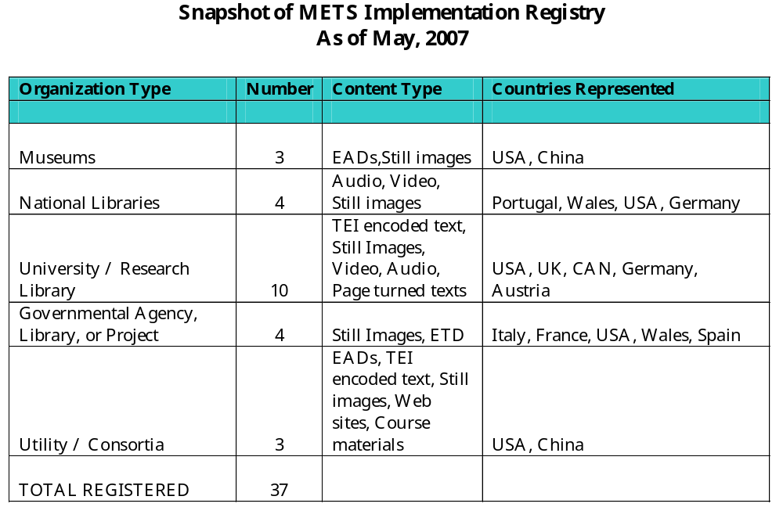
Who uses METS? For what?

Slide 7
From the field
PREMIS Implementation survey (2004)
  51 institutions: 64% of libraries, 42% of archives, 35% of other were using or planning to use METS
Digital repository open source software systems currently using/supporting METS
  Greenstone (import and internal)
  Fedora (import and export)
  Dspace (import, export, internal)
Notes:
“for non-descriptive metadata, METS [sic] was by far the most commonly used metadata scheme: 64% of libraries, 42% of archives, and 35% of other institutions used, or planned to use METS.” [1] [NOTE: Fifty-one self-described “preservation” institutions around the world completed the PREMIS Implementation Survey.]
[1] “OCLC/RLG PREMIS Working Group. 2004. “Implementing Preservation Repositories for Digital Materials: Current Practice and Emerging Trends in the Cultural Heritage Community.” Report by the joint OCLC/RLG Working Group Preservation Metadata: Implementation Strategies (PREMIS). Dublin, O.: OCLC Online Computer Library Center, Inc. Available online at: http://www.oclc.org/reearch/projects/pmwg/surveyreport.pdf (PDF:668K/66 pp.); p. 6.

Slide 8
METS & other packaging specifications
  IMS-CP from learning technology community
  MPEG21 (DIDL) from commercial industries
    More abstract than METS
  XFDU (XML Formatted Data Units)
    from Consultative Committee for Space Data Systems & developed for scientific datasets
    Used METS as starting point
  RAMLET (IEEE LTSC initiative) in process
    a reference model encompassing many content packaging schemas
    designed to facilitate the dis-/re- aggregation of resources for sharing among systems such as VLE’s / CMS’s / IR’s

Slide 9
METS Technical Components
Primary XML Schema
Extension Schema
Controlled Vocabularies
METS Profiles

Slide 10
METS XML Schema
METS Document
Header
Struct. Map
File List
Descrip. MD
Admin MD
Struct. Link
Behaviors

Slide 11
Structural Map: structMap
Object modeled as tree structure (e.g., book with chapters with subchapters….)
Every node in tree can be associated with descriptive/administrative metadata
Can describe relationships among:
  Integral files, whether individual or multiple
  Parts of files
  Sets of files or parts of files played in sequence
  Sets of files or parts of files in parallel
  Other METS documents (nested)
  Other structural divisions in non-hierarchical (hypertext) fashion

Slide 12
File Inventory: fileSec
Records file specific technical metadata (checksum, file size, creation date/time) as well as identifying component files
Files are arranged into groups, which can be arranged hierarchically
Files may be referenced (using Xlink) or contained within the METS document (in XML or as Base64 Binary)

Slide 13
MD sections: <dmdSec> & <amdSec>
Assumes different communities need to develop own element sets
Provides wrapper for externally defined descriptive / admin element sets that can be:
  internal (XML or binary) or
  external (referenced by XLink) to METS document
Non-prescriptive/Multiple instances
Can be associated with entirety of METS object or subcomponents

Slide 14
METS Header: metsHdr
Metadata regarding METS document
  CREATEDATE, MODIFYDATE, etc.
  Agents (Creator, Editor, etc.)
Alternative Record ID values

Slide 15
Structural Linking Section: structLink
Multiple links allowed within any METS document
Useful for mapping between structural maps, e.g., for web sites

Slide 16
Behaviors Section: behaviorSec
Multiple Behaviors allowed for any METS document
Behaviors may operate on any part of METS document
May provide information on API, service location, etc.

Slide 17
METS Extension Schema
Descriptive Metadata (e.g., DC, MARC, MODS)
Administrative Metadata: 4 buckets
  Technical (image, text, audio, video formats)
  IP Rights (XrML, ODRL, metsRights)
  Digital Provenance (persistent file & DO information, capture/migration, e.g., PREMIS)
  Source (analog or digital)

Slide 18
METS Controlled Vocabularies
Known metadata types (EAD, TEI, VRA)
Known file address types (xptr, time code, xlink, etc.)
METS profiles provide mechanism for sharing CV’s

Slide 19
METS Profiles
Mechanism for more specificity within the METS schema
Possibility of sharing among institutions
Drafting & sharing before registration – METS wiki
Registration process

Slide 20
Maintaining the specifications
Library of Congress Maintenance Agency hosts & provides:
  Website (Documentation)
  Listserv
  Vocabulary/Profile Registries

Slide 21
Maintaining the specifications
METS Editorial Board committed to ongoing development of:
  METS & METS Profile Schemas
  Pertinent community based extension schemas
  Controlled vocabularies
  Registries and education
  Documentation & training
  Community development

Slide 22
METS Schema Development Status
Version 1.6 Complete
Formally endorsed by DLF in 2003
NISO registration as of 2004 & renewed in 2006
Considering entering standards process for NISO / ISO

Slide 23
Documentation & Training
New Primer & Reference manual imminent – as PDF & Print on Demand
More info on the METS website and METS wiki including:
  Example & draft METS Documents
  Draft METS Profiles
Training videos, tutorials in development
More training? Useful form, topics?

Slide 24
Building the METS community
METS website: http://www.loc.gov/standards/mets
  Implementation Registry
  Tools
METS wiki: http://www.socialtext.net/mim-2006/
  Implementation issues
  Drafts of METS documents, profiles
METS listserv
METS Implementation meetings
METS Open Board meetings
Other ideas?

Slide 25
Questions? Comments?
Next: Rick Beaubien
Nancy Hoebelheinrich, nhoebel@stanford.edu
Stanford University Libraries

